Slide 1
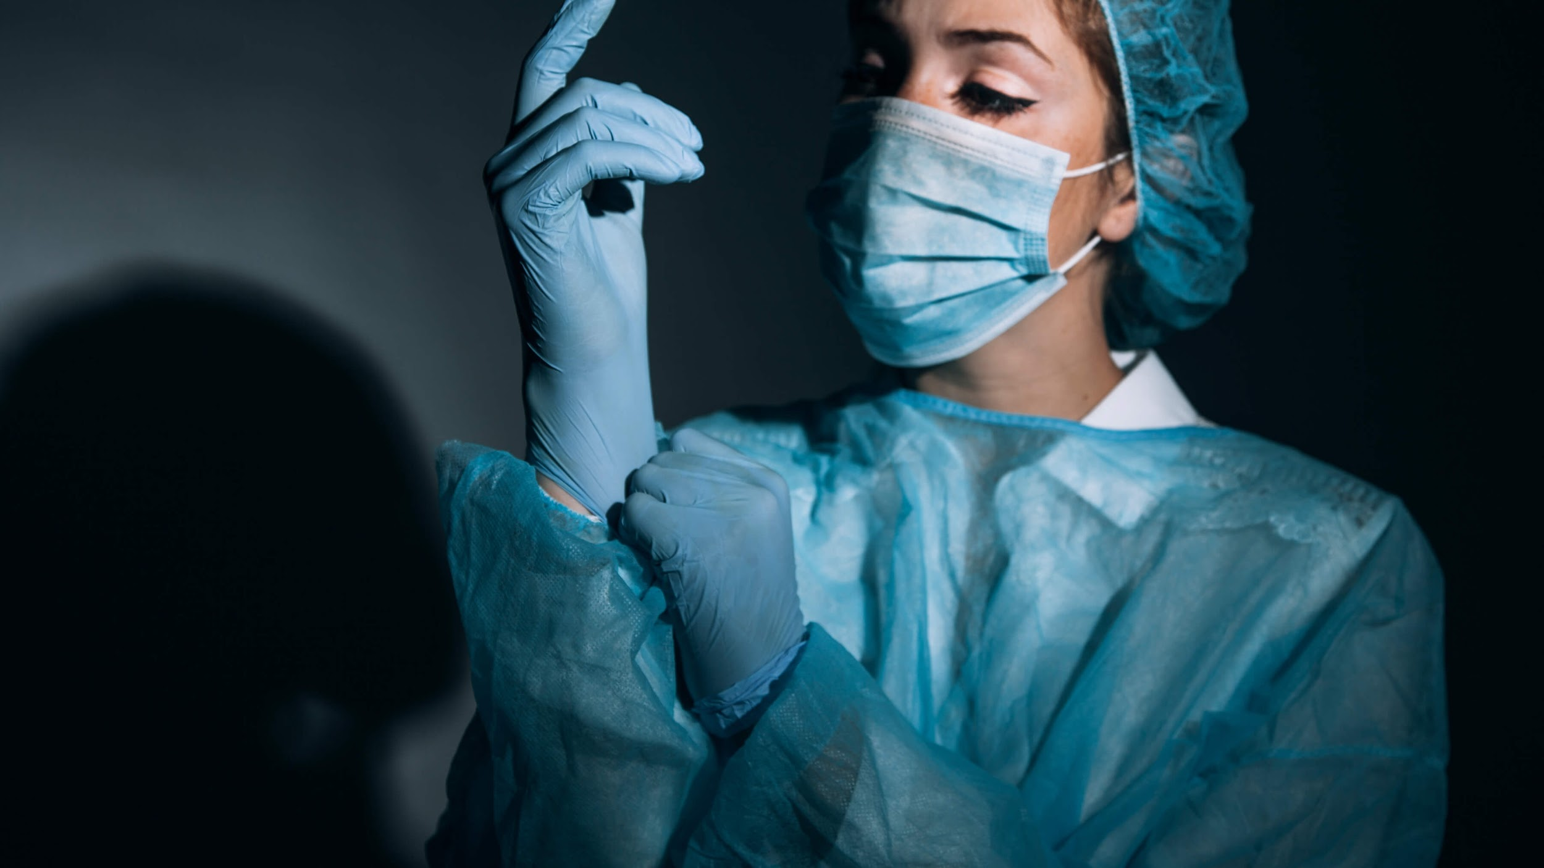
POST OPERATIVE NAUSEA AND VOMITING (PONV)
By Paul Chung

Slide 2
WHAT IS IT?
Nausea, retching, or vomiting during the first 24-48 hours after surgery

Slide 3
WHO CARES?
Patients
30% of all post-surgical patients experience PONV
Would prefer pain to nausea
Manage Expectations
Notes:
Given proportion of patients who experience PONV
Unpleasant

Slide 4
WHO CARES?
Care Providers
Cost of drugs for prophylactic treatment
Resources for increased recovery time
Lower insurance reimbursements
Better Informed
Notes:
It’s about cost and the patient
Survey for patient experience

Slide 5
5 PROBABILITIES
 | Apfel | Koivuranta
Target Scale | 10%, 20%, 40%, 60%, 80% | 18%, 42%, 54%, 74%, 87%
Features | Gender, smoking status, history of nausea, post-op opioids | Same as Apfel (replace post-op opioids w/ surgery time)

Slide 6
OBJECTIVES
01
Increase precision of probabilities
Notes:
Manage Patient Expectations and Better Inform Doctors
More precise measurements
Incorporate More Features
Improve Metrics

Slide 7
OBJECTIVES
01
02
Increase precision of probabilities
Incorporate More Features
Notes:
Manage Patient Expectations and Better Inform Doctors
More precise measurements (continuous scale)
Incorporate More Features (show patients the factors)
Improve Metrics

Slide 8
OBJECTIVES
01
02
03
Increase precision of probabilities
Incorporate More Features
Improve metrics
Notes:
Manage Patient Expectations and Better Inform Doctors
More precise measurements
Incorporate More Features
Vs. Apfel (later I’ll talk about coming across the actual paper)

Slide 9
APPROACH
01
02
03
Model: Logistic Regression
Data: Development of multivariable predictive model for PONV after cancer surgery in adults
Metrics: a) ROC/AUC; b) F1
Notes:
Not only did it perform the best but output probability was important so I was leaning in this direction
Conceptually the same as predicting PONV in regular patients except the added feature of patient’s chemo experience (yes/no, how long, did you experience nausea from chemo?) Note: 30% PONV in sample population, which is consistent with the rate cited in other research papers. It’s what was available for the topic
Maximize ROC/AUC and then find the threshold that gives the optimal F1. The reason for F1 is because there’s a tradeoff…

Slide 10
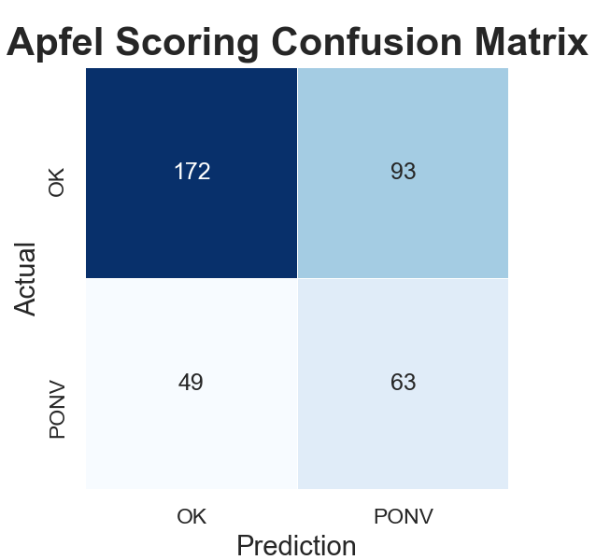
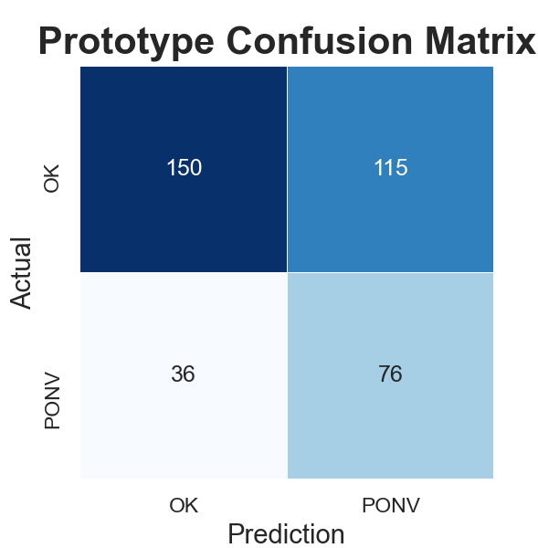
RESULTS
Notes:
Key: 25% reduction in false negatives
Hard to definitely say
patient receiving

Slide 11
BETTER THAN APFEL
 | Apfel | Prototype
AUC | 60.6% | 62.2%
F1 | 47.0% | 50.2%
Notes:
There was an incremental increase

Slide 12
APP DEMO
Notes:
Finding the actual research paper:
My coefficients for antiemetics was positive
I also think the prior PONV/sensitivity Nausea should be separate categories. Are you really predicting nausea if the patient has had it before?
Length of surgeries and duration over which anesthetics would be great to incorporate (combining metrics of the Koivuranta)
Use non-onchologic patients and use medical practices more prevalent in the US

Slide 13

TAKEAWAYS
Tradeoff in complexity vs. incremental improvement
Larger number of false positives vs. less false negatives
Patients have a tool to be informed and ask questions
Notes:
Did I make a “better” model – debatable.
First step/phase to making a better one

Slide 14
OTHER INSIGHTS
LEAKAGE
Additional Features
DATA
Antiemetics in analysis
Prior PONV
Length of Surgeries
Smoking specifics
Non-Onchology Patients
US Medical Practices
Notes:
Finding the actual research paper:
My coefficients for antiemetics was positive
I also think the prior PONV/sensitivity Nausea should be separate categories. Are you really predicting nausea if the patient has had it before?
Length of surgeries and duration over which anesthetics would be great to incorporate (combining metrics of the Koivuranta)
Use non-onchologic patients and use medical practices more prevalent in the US

Slide 15
RESULTS
 | Apfel | Prototype | University
AUC | 60.6% | 62.2% | 67.9%
F1 | 47.0% | 50.2% | N/A
Notes:
Talk about the actual research paper?

Slide 16
REFERENCES
https://www.scielo.br/scielo.php?pid=S0034-70942019000400003&script=sci_arttext
AUTHOR (YEAR). Title of the publication. Publisher
AUTHOR (YEAR). Title of the publication. Publisher
AUTHOR (YEAR). Title of the publication. Publisher
AUTHOR (YEAR). Title of the publication. Publisher
AUTHOR (YEAR). Title of the publication. Publisher

Slide 17
RESOURCES
https://www.scielo.br/scielo.php?pid=S0034-70942019000400003&script=sci_arttextDentist looking at radiography in office
Scientist making test in laboratory
Doctor hands giving pills to patient
Doctor shaking hand with patient
Doctor talking with senior woman
Doctor tending to a patient
Close-up of lab technician doing experiment in lab

